Slide 1
Power Enjoy
Software Engineering Project
Oral Discussion
Notes:
Rémi
Car sharing service
Electric Car

Slide 2
Plan
Project Initiatives
Implementation Diagrams
Integration
Testing
Project Management
Notes:
Noëlie

Slide 3
Requirements
Possibility of cancelling a reservation
1€ fee
Unable to book a car within the next 2 hours
Time limitation for not picking a booked car
1€ fee
Unable to book within the next 3 hours
Notes:
Vianney

Slide 4
Assumptions
A driver who unlocks a car will ignite the engine
You can only use the smartphone application to access the system
The society has a maintenance and insurance service for cars
Notes:
Vianney

Slide 5
Scenario Example
Notes:
Rémi
Scenario involving the previously explained requirements
Specifications => Implementation
High Level
DB models

Slide 6
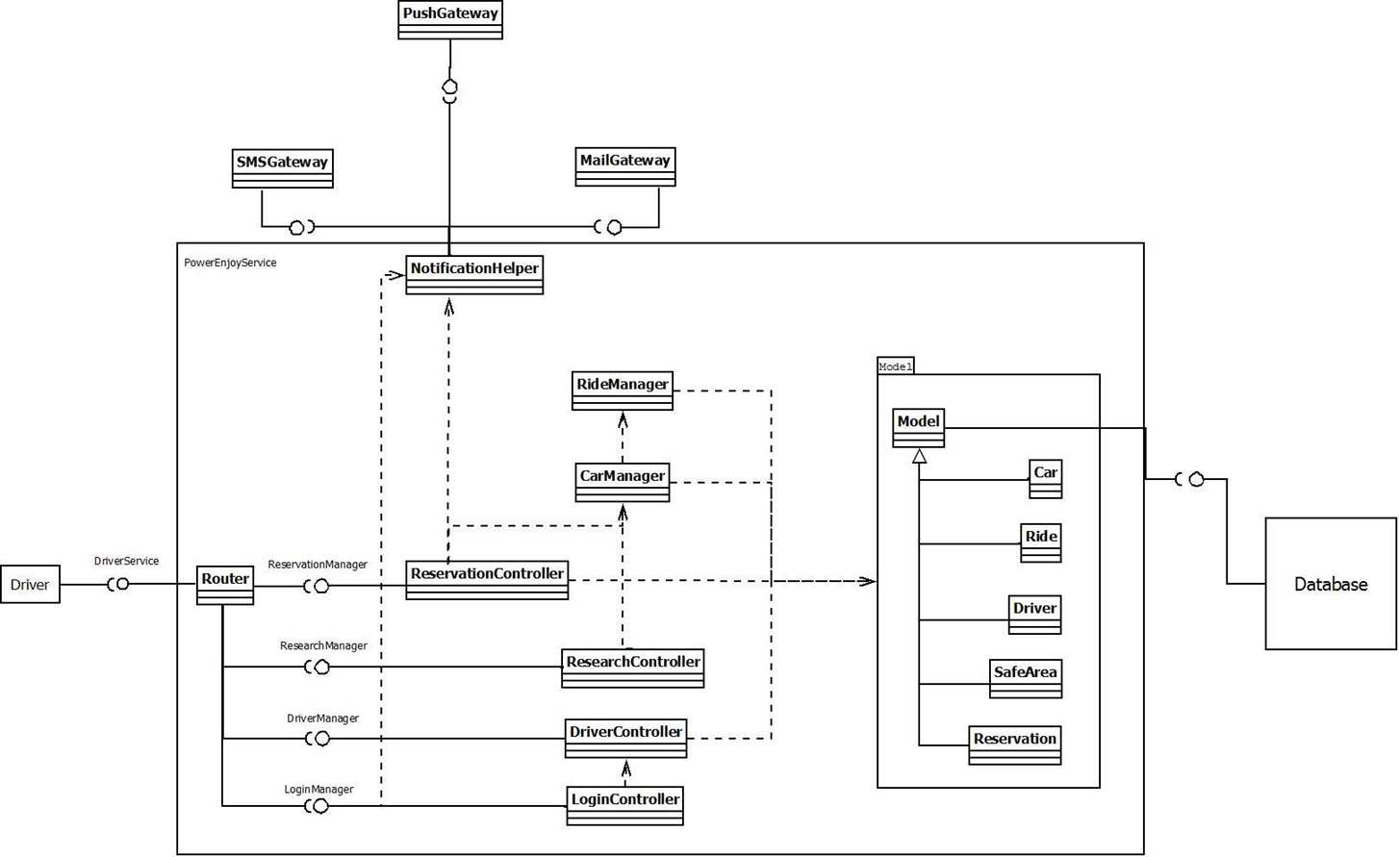
Component Diagram
Notes:
Rémi
Models -> Controllers
Driver
Notifications
-> Use of third party components
-> Dependencies
-> Lead to integration

Slide 7
BCE Diagram
Notes:
Noëlie

Slide 8
Deployment Diagram
Notes:
Noëlie
Transition DD -> Integration

Slide 9
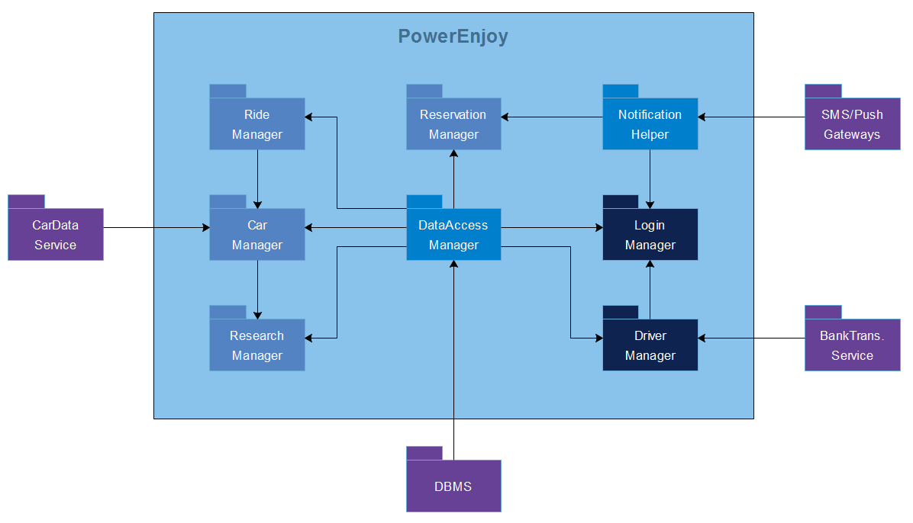
Component Integration
Notes:
Rémi
Bottom up approach
-> speed up the development
-> early tests
Arrow -> Integration order
Integration
DBMS
Third Party
Rest

Slide 10
Test Case/Procedure Examples
Test Case identifier | I1T1
Items tested | DBMS → DataAccess Manager
Input specifications | DBMS output
Pass criteria | - The DataAccess Manager check that the data coming in and out are valid
 | - If the data coming in are valid, check that it calls the right methods
 | - If the data are not valid, signal an error in the process and check that the error has been caught
Environmental needs | DBMS driver
Test Case identifier | I1T1
Test Procedure identifier | TP3
Item to test | Car Management System
Purpose | This test will check if the Car Management System :
 | - Know the information about rides and reservations
 | - Know the current information about every single car
 | - Can use those information to signal problems
 | - Can share those information with the persons in charge of the cars
Steps | I1 → I3, I1-I2 → I6, I1-I3 → I4, I1-I4→ I5
Notes:
Vianney
Noëlie: Used Tools presentation ?

Slide 11
Cocomo II – Function Points
Software analysis |  |  |  | Total
Inputs | 3 | 4 | 2 | 37
Outputs | 3 | 0 | 1 | 19
Inquiry | 2 | 2 | 0 | 14
ILF | 6 | 0 | 0 | 42
ELF | 0 | 1 | 0 | 7
 |  |  | Total | 119
High estimation | Low estimation
4998 | 7973
Notes:
Vianney

Slide 12
Cocomo II – Cost Estimation
 | Very Low | Low | Nominal | High | Very High | Extra High | Average
Precedentness | 6,2 | 4,96 | 3,72 | 2,48 | 1,24 | 0
#Elements | 1 | 0 | 1 | 0 | 0 | 2 | 2,48
Flexibility | 5,07 | 4,05 | 3,04 | 2,03 | 1,01 | 0
#Elements | 0 | 0 | 2 | 0 | 0 | 1 | 2,03
Resolution | 7,07 | 5,65 | 4,24 | 2,83 | 1,41 | 0
#Elements | 0 | 3 | 4 | 0 | 0 | 0 | 4,84
Team cohesion | 5,48 | 4,38 | 3,29 | 2,19 | 1,1 | 0
#Elements | 0 | 0 | 0 | 1 | 1 | 0 | 1,65
Process Maturity | 7,8 | 6,24 | 4,68 | 3,12 | 1,56 | 0
#Elements | 0 | 0 | 0 | 1 | 0 | 0 | 3,12
 |  |  |  |  |  | SF Total | 14,12
 | High estimation | Low estimation
Effort (person-month) | 11,58 | 18,91
Duration (month) | 7,81 | 9,08
Notes:
Vianney

Slide 13
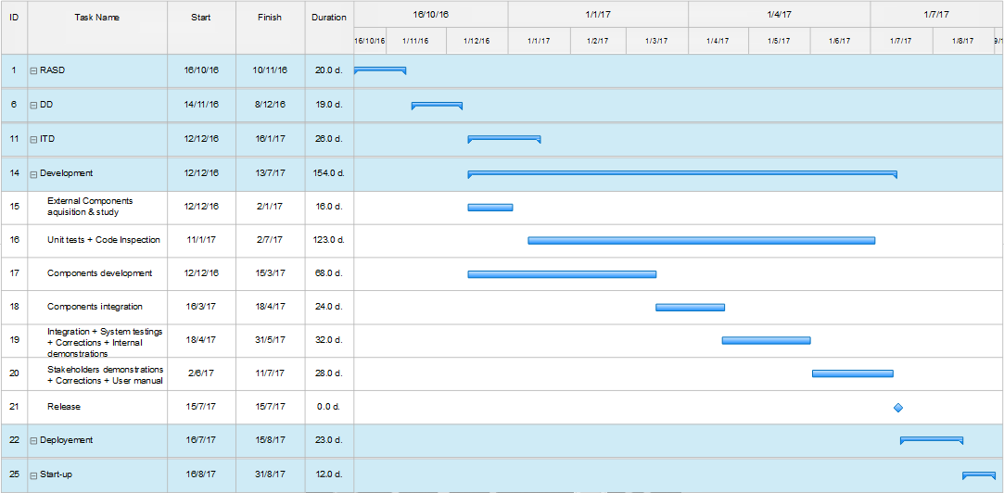
Gantt’s Diagram
Notes:
Noëlie

Slide 14
Resource Allocation
Notes:
Noëlie

Slide 15

Thank you
Notes:
Noëlie

